Slide 1
Planning and controlling

Slide 2

Management of Projects
Planning - goal setting, defining the project, team organization
Scheduling - relate people, money, and supplies to specific activities and activities to each other
Controlling - monitor resources, costs, quality, and budgets; revise plans and shift resources to meet time and cost demands

Slide 3
Project Management Activities
Planning
Objectives
Resources
Work break-down structure
Organization
Scheduling
Project activities
Start & end times
Network
Controlling
Monitor, compare, revise, action

Slide 4

Project Planning
Establishing objectives
Defining project
Creating work breakdown structure
Determining resources
Forming organization

Slide 5

Project Organization
Often temporary structure
Uses specialists from entire company
Headed by project manager
Coordinates activities
Monitors schedule and costs
Permanent structure called ‘matrix organization’

Slide 6
Project Organization Works Best When
Work can be defined with a specific goal and deadline
The job is unique or somewhat unfamiliar to the existing organization
The work contains complex interrelated tasks requiring specialized skills
The project is temporary but critical to the organization
The project cuts across organizational lines

Slide 7
The Role of the Project Manager
Highly visible
Responsible for making sure that:
All necessary activities are finished in order and on time
The project comes in within budget
The project meets quality goals
The people assigned to the project receive motivation, direction, and information

Slide 8
Ethical Issues
Project managers face many ethical decisions on a daily basis
The Project Management Institute has established an ethical code to deal with problems such as:
Offers of gifts from contractors
Pressure to alter status reports to mask delays
False reports for charges of time and expenses
Pressure to compromise quality to meet schedules

Slide 9
Work Breakdown Structure
Level
1. Project
2. Major tasks in the project
3. Subtasks in the major tasks
4. Activities (or “work packages”) to be completed

Slide 10
Work Breakdown Structure
Level 1
Develop Windows 8 Operating System
1.0
Level 2
Software Design
1.1
Cost Management Plan
1.2
System Testing
1.3
Level 3
Develop GUIs
1.1.1
Design Cost Tracking Reports
1.2.1
Module Testing
1.3.1
Ensure Compatibility with Earlier Versions
1.1.2
Develop Cost/Schedule Interface
1.2.2
Defect Testing
1.3.2
Level 4
Compatible with Windows 7
1.1.2.1
(Work packages)
Compatible with Windows Vista
1.1.2.2
Compatible with Windows XP
1.1.2.3
Figure 3.3

Slide 11

Project Scheduling Techniques
Ensure that all activities are planned for
Their order of performance is accounted for
The activity time estimates are recorded
The overall project time is developed

Slide 12
Purposes of Project Scheduling
Shows the relationship of each activity to others and to the whole project
Identifies the precedence relationships among activities
Encourages the setting of realistic time and cost estimates for each activity
Helps make better use of people, money, and material resources by identifying critical bottlenecks in the project

Slide 13

Project Management Techniques
Gantt chart
Critical Path Method (CPM)
Program Evaluation and Review Technique (PERT)

Slide 14
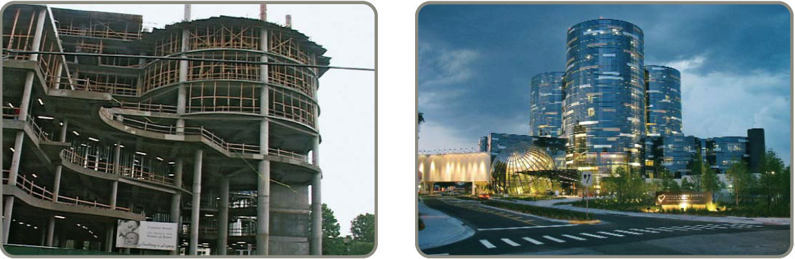
Project Controlling
Close monitoring of resources, costs, quality, budgets
Feedback enables revising the project plan and shift resources
Computerized tools produce extensive reports

Slide 15
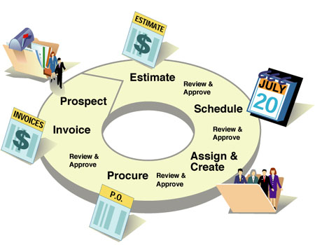
Project Management Software
There are several popular packages for managing projects:
Primavera
MacProject
MindView
HP Project
Fast Track
Microsoft Project

